Slide 1
Covariance, stationarity & some useful operators
Mark Scheuerell
FISH 507 – Applied Time Series Analysis
5 January 2017

Slide 2
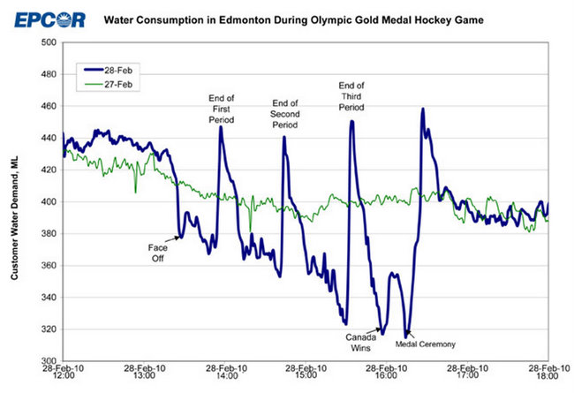
Example of a time series

Slide 3
Topics for today
Expectation, mean & variance
Covariance & correlation
Stationarity
Autocovariance & autocorrelation
Correlograms
White noise
Random walks
Backshift & difference operators

Slide 4
Expectation, mean & variance
The expectation (E) of a variable is its mean value in the population
E(x) ≡ mean of x = μ
E([x - μ]²) ≡ mean of squared deviations about μ
≡ variance = σ²
Can estimate σ² from sample as

Slide 5
Covariance
If we have 2 variables (x, y) we can generalize variance
to covariance
Can estimate γ from sample as

Slide 6
Graphical example of covariance

Slide 7
Correlation
Correlation is a dimensionless measure of the linear association between 2 variables x & y
It is simply the covariance standardized by the standard deviations
Can estimate γ from sample as

Slide 8
The ensemble & stationarity
Consider again the mean function for a time series:
μ(t) = E(x_{t})
The expectation is taken across an ensemble (population) of all possible time series
With only 1 sample, however, we must estimate the mean at each time point by the observation
If E(x_{t}) is constant across time, we say the time series is stationary in the mean

Slide 9
Stationarity of time series
Stationarity is a convenient assumption that allows us to describe the statistical properties of a time series.
In general, a time series is said to be stationary if there is
no systematic change in the mean or variance,
no systematic trend, and
no periodic variations or seasonality

Slide 10
Which of these are stationary?

Slide 11
Autocovariance function (ACVF)
For stationary ts, we can define the autocovariance function (ACVF) as a function of the time lag (k)
Very “smooth” series have large ACVF for large k; “choppy” series have ACVF near 0 for small k
Can estimate γ_{k} from sample as

Slide 12
Autocorrelation function (ACF)
The autocorrelation function (ACF) is simply the ACVF normalized by the variance
ACF measures the correlation of a time series against a time-shifted version of itself (& hence the term “auto”)
Can estimate γ_{k} from sample as

Slide 13
Properties of the ACF
The ACF has several important properties, including
-1 ≤ r_{k} ≤ 1,
r_{k} = r_{-k} (ie, it’s an “even function”),
r_{k} of periodic function is itself periodic
r_{k} for sum of 2 indep vars is sum of r_{k} for each

Slide 14
The correlogram
The common graphical output for the ACF is called the correlogram, and it has the following features:
x-axis indicates lag (0 to k);
y-axis is autocorrelation r_{k} (-1 to 1);
lag-0 correlation (r₀) is always 1 (it’s a ref point);
If ρ_{k} = 0, then sampling distribution of r_{k} is approx. normal, with var = 1/n;
Thus, a 95% conf interval is given by

Slide 15
The correlogram

Slide 16
Correlogram for deterministic trend

Slide 17
Correlogram for sine wave

Slide 18
Correlogram for trend + season

Slide 19
Correlogram for random sequence

Slide 20
Correlogram for real data

Slide 21
Partial autocorrelation function
The partial autocorrelation function (PACF) measures the linear correlation of a series x_{t} and x_{t+k} with the linear dependence of {x_{t-1},x_{t-2},…,x_{t-(k-1)}} removed
It is defined as

Slide 22
Revisiting the temperature ts
Data from http://www.ncdc.noaa.gov/

Slide 23
ACF of temperature ts

Slide 24
PACF of temperature ts

Slide 25
Cross-covariance function (CCVF)
Often we are interested in looking for relationships between 2 different time series
We can extend the idea of autocovariance to examine the covariance between 2 different ts
Define the cross-covariance function (CCVF) for x & y

Slide 26
Cross-correlation function (CCF)
The cross-correlation function (CCF) is the CCVF normalized by standard deviations of x & y

Slide 27
CCF for sunspots and lynx

Slide 28
Iterative approach to model building
Postulate general class of models
As we will see later, ACF & PACF will be very useful here
Identify candidate model
Estimate parameters
Diagnostics:
is model adequate?
Use model for forecasting or control
No
Yes

Slide 29
White noise (WN)
A time series {w_{t} : t = 1,2,3,…,n} is discrete white noise if the variables w₁, w₂, w₃, …, w_{n} are
independent, and
identically distributed with a mean of zero
Note: At this point we are making no assumptions about the distributional form of {w_{t}}!
For example, w_{t} might be distributed as
DiscreteUniform({-2,-1,0,1,2})
Normal(0,1)

Slide 30
White noise (WN)
A time series {w_{t} : t = 1,2,3,…,n} is discrete white noise if the variables w₁, w₂, w₃, …, w_{n} are
independent, and
identically distributed with a mean of zero
Gaussian WN has the following 2nd-order properties:

Slide 31
White noise

Slide 32
Random walk (RW)
A time series {x_{t} : t = 1,2,3,…,n} is a random walk if
x_{t} = x_{t-1} + w_{t}, and
w_{t} is white noise
RW has the following 2nd-order properties:
Note: Random walks are NOT stationary!

Slide 33
Random walk (RW)

Slide 34
The backward shift operator (B)
Define the backward shift operator by
Or, more generally as
So, RW model can be expressed as

Slide 35
The difference operator (∇)
Define the first difference operator as
So, first differencing a RW model yields WN

Slide 36
The difference operator (∇)
Differences of order d are then defined by
For example, twice differencing a ts

Slide 37
Difference to remove trend/season
Differencing is a very simple means for removing a trend or seasonal effect
The 1st-difference removes a linear trend, a 2nd-difference would remove a quadratic trend, etc.
For seasonal data, using a 1st-difference with lag = period removes both trend & seasonal effects
Pro: no parameters to estimate
Con: no estimate of stationary process

Slide 38
First-difference to remove trend

Slide 39
First-difference* to remove season
*At lag = 12

Slide 40
Topics for today
Expectation, mean & variance
Covariance & correlation
Stationarity
Autocovariance & autocorrelation
Correlograms
White noise
Random walks
Backshift & difference operators

